Slide 1




My Algebra Interactive Notebook
$$3ab$$
$$2x+3y$$
$$\frac{5xy}{6}$$
Name :
Class : Mrs Keen
Term 2 Semester 1
$$y=2x+1$$

Slide 2
Contents
Glossary
Page
Date
Description
2
3

Slide 3
Tasks
24
7
30
Essential Question
Questions
Notes
Summary
4
5

Slide 4
24
7
30
Date
Fractions
EQ – What do you do when you add or subtract fractions?
5

Slide 5
24
7
30
Date
Fractions
EQ – What do you do when you add or subtract fractions?
What’s important when adding or subtracting fractions?
5

Slide 6
24
7
30
Date
Fractions
EQ – What do you do when you add or subtract fractions?
What’s important when adding or subtracting fractions?
You can only add or subtract fractions when the denominators are the same.
5

Slide 7
24
7
30
Date
Fractions
EQ – What do you do when you add or subtract fractions?
What’s important when adding or subtracting fractions?
You can only add or subtract fractions when the denominators are the same.
What do you do first?
5

Slide 8
24
7
30
Date
Fractions
EQ – What do you do when you add or subtract fractions?
What’s important when adding or subtracting fractions?
You can only add or subtract fractions when the denominators are the same.
What do you do first?
First, find the lowest common multiple (LCM) of the denominators.
5

Slide 9
24
7
30
Date
Fractions
EQ – What do you do when you add or subtract fractions?
What’s important when adding or subtracting fractions?
You can only add or subtract fractions when the denominators are the same.
What do you do first?
First, find the lowest common multiple (LCM) of the denominators.
Is there a trick to finding the LCM quickly?
5

Slide 10
24
7
30
Date
Fractions
EQ – What do you do when you add or subtract fractions?
What’s important when adding or subtracting fractions?
You can only add or subtract fractions when the denominators are the same.
What do you do first?
First, find the lowest common multiple (LCM) of the denominators.
Is there a trick to finding the LCM quickly?
Often, the LCM occurs when the denominators are multiplied together BUT, not always.
5

Slide 11
24
7
30
Date
Fractions
EQ – What do you do when you add or subtract fractions?
What’s important when adding or subtracting fractions?
You can only add or subtract fractions when the denominators are the same.
What do you do first?
First, find the lowest common multiple (LCM) of the denominators.
Is there a trick to finding the LCM quickly?
Often, the LCM occurs when the denominators are multiplied together BUT, not always.
What next?
5

Slide 12
24
7
30
Date
Fractions
EQ – What do you do when you add or subtract fractions?
What’s important when adding or subtracting fractions?
You can only add or subtract fractions when the denominators are the same.
What do you do first?
First, find the lowest common multiple (LCM) of the denominators.
Is there a trick to finding the LCM quickly?
Often, the LCM occurs when the denominators are multiplied together BUT, not always.
What next?
Make each fraction equivalent to its original but now they both have the same denominator.
5

Slide 13
24
7
30
Date
Fractions
EQ – What do you do when you add or subtract fractions?
What’s important when adding or subtracting fractions?
You can only add or subtract fractions when the denominators are the same.
What do you do first?
First, find the lowest common multiple (LCM) of the denominators.
Is there a trick to finding the LCM quickly?
Often, the LCM occurs when the denominators are multiplied together BUT, not always.
What next?
Make each fraction equivalent to its original but now they both have the same denominator.
Then, add or subtract the numerators. DO NOT do anything with the denominator. That stays the same.
5

Slide 14
24
7
30
Date
Fractions
EQ – What do you do when you add or subtract fractions?
What’s important when adding or subtracting fractions?
You can only add or subtract fractions when the denominators are the same.
What do you do first?
First, find the lowest common multiple (LCM) of the denominators.
Is there a trick to finding the LCM quickly?
Often, the LCM occurs when the denominators are multiplied together BUT, not always.
What next?
Make each fraction equivalent to its original but now they both have the same denominator.
Then, add or subtract the numerators. DO NOT do anything with the denominator. That stays the same.
Finally, Simplify! (cancel down to the smallest numbers possible; make improper fractions into mixed number fractions).
5

Slide 15

Some examples
$\frac{1}{5}+ \frac{2}{5}=$
$\frac{1}{3}+\frac{3}{5}=$
$\frac{2}{5}+\frac{11}{15}=$
3$\frac{3}{4}−$ 1$\frac{1}{2}=$

Slide 16

Some examples
$\frac{1}{5}+ \frac{2}{5}= \frac{1+2}{5}=$
$\frac{1}{3}+\frac{3}{5}=$
$\frac{2}{5}+\frac{11}{15}=$
3$\frac{3}{4}−$ 1$\frac{1}{2}=$

Slide 17

Some examples
$\frac{1}{5}+ \frac{2}{5}= \frac{1+2}{5}=\frac{3}{5}$
$\frac{1}{3}+\frac{3}{5}=$
$\frac{2}{5}+\frac{11}{15}=$
3$\frac{3}{4}−$ 1$\frac{1}{2}=$
Add the numerators
Denominator stays the same

Slide 18
Some examples
$\frac{1}{5}+ \frac{2}{5}= \frac{1+2}{5}=\frac{3}{5}$
$\frac{1}{3}+\frac{3}{5}=$
$\frac{2}{5}+\frac{11}{15}=$
3$\frac{3}{4}−$ 1$\frac{1}{2}=$
Add the numerators
Denominator stays the same
x5
x3
x5
x3

Slide 19

Some examples
$\frac{1}{5}+ \frac{2}{5}= \frac{1+2}{5}=\frac{3}{5}$
$\frac{1}{3}+\frac{3}{5}= \frac{5}{15}+\frac{9}{15}=$
$\frac{2}{5}+\frac{11}{15}=$
3$\frac{3}{4}−$ 1$\frac{1}{2}=$
Add the numerators
Denominator stays the same
x5
x3
x5
x3

Slide 20

Some examples
$\frac{1}{5}+ \frac{2}{5}= \frac{1+2}{5}=\frac{3}{5}$
$\frac{1}{3}+\frac{3}{5}= \frac{5}{15}+\frac{9}{15}=\frac{5+9}{15}=\frac{14}{15}$
$\frac{2}{5}+\frac{11}{15}=$
3$\frac{3}{4}−$ 1$\frac{1}{2}=$
Add the numerators
Denominator stays the same
x5
x3
x5
x3

Slide 21
Some examples
$\frac{1}{5}+ \frac{2}{5}= \frac{1+2}{5}=\frac{3}{5}$
$\frac{1}{3}+\frac{3}{5}= \frac{5}{15}+\frac{9}{15}=\frac{5+9}{15}=\frac{14}{15}$
$\frac{2}{5}+\frac{11}{15}=$
3$\frac{3}{4}−$ 1$\frac{1}{2}=$
Add the numerators
Denominator stays the same
x5
x3
x5
x3
x3
x3

Slide 22

Some examples
$\frac{1}{5}+ \frac{2}{5}= \frac{1+2}{5}=\frac{3}{5}$
$\frac{1}{3}+\frac{3}{5}= \frac{5}{15}+\frac{9}{15}=\frac{5+9}{15}=\frac{14}{15}$
$\frac{2}{5}+\frac{11}{15}=\frac{6}{15}+\frac{11}{15}$
3$\frac{3}{4}−$ 1$\frac{1}{2}=$
Add the numerators
Denominator stays the same
x5
x3
x5
x3
x3
x3

Slide 23

Some examples
$\frac{1}{5}+ \frac{2}{5}= \frac{1+2}{5}=\frac{3}{5}$
$\frac{1}{3}+\frac{3}{5}= \frac{5}{15}+\frac{9}{15}=\frac{5+9}{15}=\frac{14}{15}$
$\frac{2}{5}+\frac{11}{15}=\frac{6}{15}+\frac{11}{15}=\frac{6+11}{15}=\frac{17}{15}$
3$\frac{3}{4}−$ 1$\frac{1}{2}=$
Add the numerators
Denominator stays the same
x5
x3
x5
x3
x3
x3

Slide 24

Some examples
$\frac{1}{5}+ \frac{2}{5}= \frac{1+2}{5}=\frac{3}{5}$
$\frac{1}{3}+\frac{3}{5}= \frac{5}{15}+\frac{9}{15}=\frac{5+9}{15}=\frac{14}{15}$
$\frac{2}{5}+\frac{11}{15}=\frac{6}{15}+\frac{11}{15}=\frac{6+11}{15}=\frac{17}{15}=1\frac{2}{15}$
3$\frac{3}{4}−$ 1$\frac{1}{2}=$
Add the numerators
Denominator stays the same
x5
x3
x5
x3
x3
x3

Slide 25
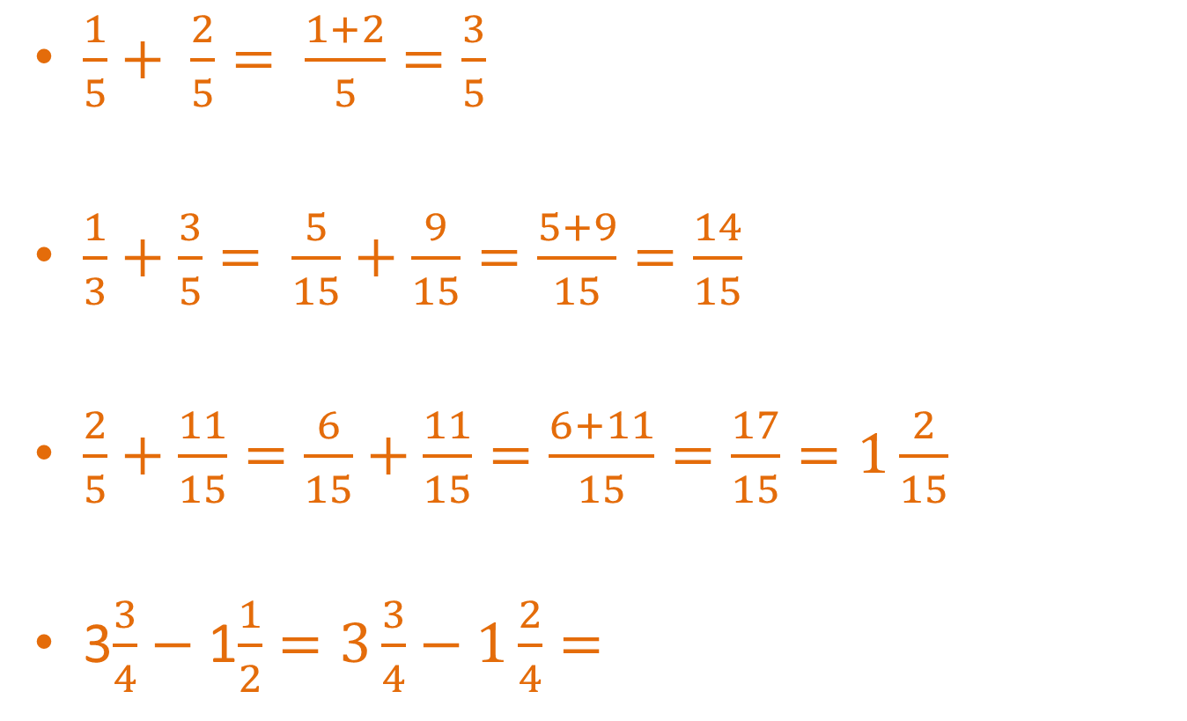
Some examples
$\frac{1}{5}+ \frac{2}{5}= \frac{1+2}{5}=\frac{3}{5}$
$\frac{1}{3}+\frac{3}{5}= \frac{5}{15}+\frac{9}{15}=\frac{5+9}{15}=\frac{14}{15}$
$\frac{2}{5}+\frac{11}{15}=\frac{6}{15}+\frac{11}{15}=\frac{6+11}{15}=\frac{17}{15}=1\frac{2}{15}$
3$\frac{3}{4}−$ 1$\frac{1}{2}=3\frac{3}{4}−1\frac{2}{4}=$
Add the numerators
Denominator stays the same
x5
x3
x5
x3
x3
x3

Slide 26
Some examples
$\frac{1}{5}+ \frac{2}{5}= \frac{1+2}{5}=\frac{3}{5}$
$\frac{1}{3}+\frac{3}{5}= \frac{5}{15}+\frac{9}{15}=\frac{5+9}{15}=\frac{14}{15}$
$\frac{2}{5}+\frac{11}{15}=\frac{6}{15}+\frac{11}{15}=\frac{6+11}{15}=\frac{17}{15}=1\frac{2}{15}$
3$\frac{3}{4}−$ 1$\frac{1}{2}=3\frac{3}{4}−1\frac{2}{4}=$
Add the numerators
Denominator stays the same
x5
x3
x5
x3
x3
x3
Only change the fraction parts

Slide 27
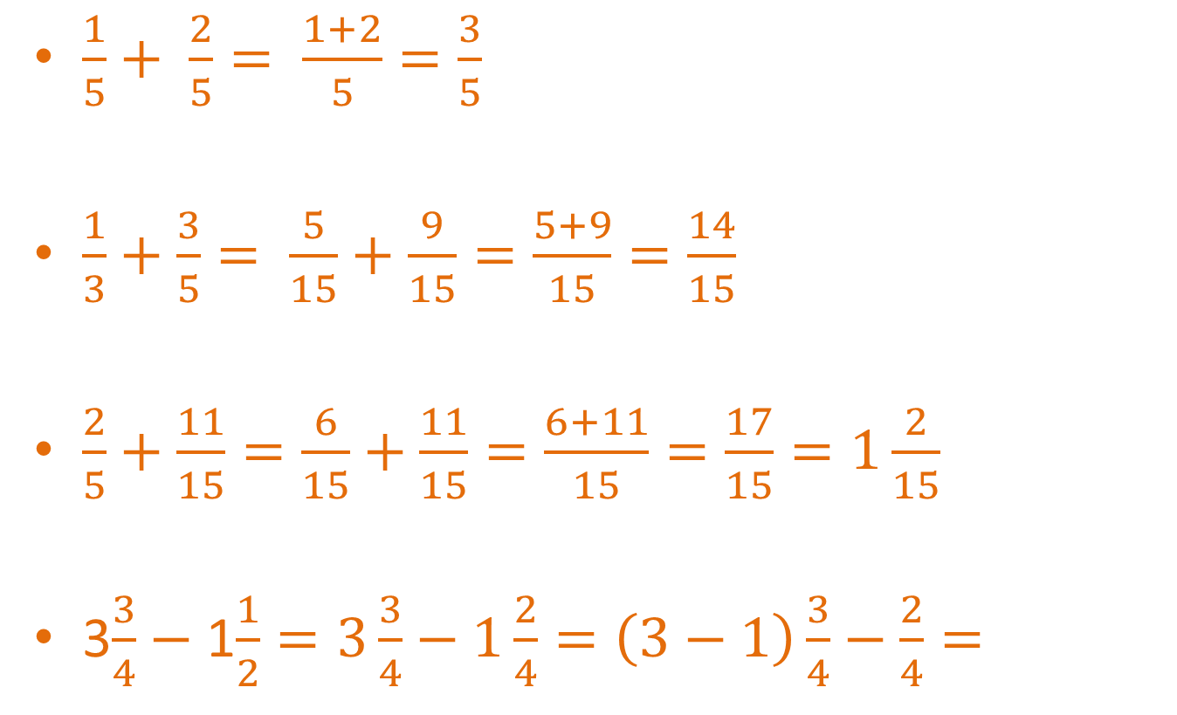
Some examples
$\frac{1}{5}+ \frac{2}{5}= \frac{1+2}{5}=\frac{3}{5}$
$\frac{1}{3}+\frac{3}{5}= \frac{5}{15}+\frac{9}{15}=\frac{5+9}{15}=\frac{14}{15}$
$\frac{2}{5}+\frac{11}{15}=\frac{6}{15}+\frac{11}{15}=\frac{6+11}{15}=\frac{17}{15}=1\frac{2}{15}$
3$\frac{3}{4}−$ 1$\frac{1}{2}=3\frac{3}{4}−1\frac{2}{4}=\left(3−1\right)\frac{3}{4}−\frac{2}{4}=$
Add the numerators
Denominator stays the same
x5
x3
x5
x3
x3
x3
Only change the fraction parts

Slide 28
Some examples
$\frac{1}{5}+ \frac{2}{5}= \frac{1+2}{5}=\frac{3}{5}$
$\frac{1}{3}+\frac{3}{5}= \frac{5}{15}+\frac{9}{15}=\frac{5+9}{15}=\frac{14}{15}$
$\frac{2}{5}+\frac{11}{15}=\frac{6}{15}+\frac{11}{15}=\frac{6+11}{15}=\frac{17}{15}=1\frac{2}{15}$
3$\frac{3}{4}−$ 1$\frac{1}{2}=3\frac{3}{4}−1\frac{2}{4}=\left(3−1\right)\frac{3}{4}−\frac{2}{4}=$
Add the numerators
Denominator stays the same
x5
x3
x5
x3
x3
x3
Only change the fraction parts
+ or – the whole numbers

Slide 29
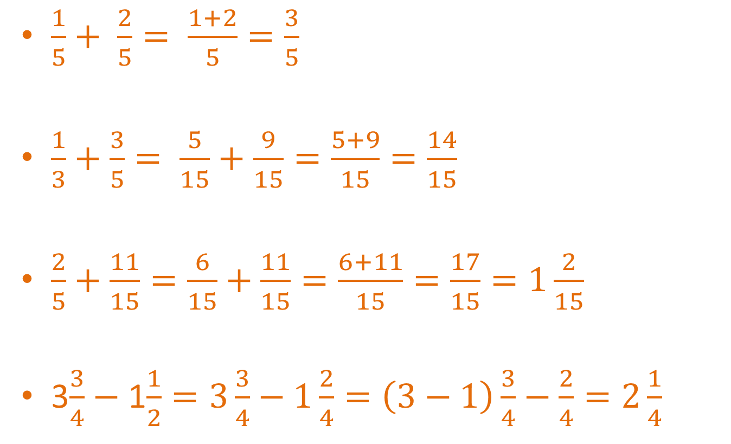
Some examples
$\frac{1}{5}+ \frac{2}{5}= \frac{1+2}{5}=\frac{3}{5}$
$\frac{1}{3}+\frac{3}{5}= \frac{5}{15}+\frac{9}{15}=\frac{5+9}{15}=\frac{14}{15}$
$\frac{2}{5}+\frac{11}{15}=\frac{6}{15}+\frac{11}{15}=\frac{6+11}{15}=\frac{17}{15}=1\frac{2}{15}$
3$\frac{3}{4}−$ 1$\frac{1}{2}=3\frac{3}{4}−1\frac{2}{4}=\left(3−1\right)\frac{3}{4}−\frac{2}{4}=2\frac{1}{4}$
Add the numerators
Denominator stays the same
x5
x3
x5
x3
x3
x3
Only change the fraction parts
+ or – the whole numbers

Slide 30

Let’s try these together
$\frac{1}{3}+\frac{5}{6}$
$\frac{3}{4}−\frac{5}{10}$
$\frac{5}{6}−\frac{3}{4}$
1$\frac{2}{3}+3\frac{3}{4}$

Slide 31
Task

Slide 32
Remember!

Slide 33
Answers

Slide 34
Notes Review
24, 7 ,30
Date
Title
Essential question
Notes complete
Notes complete with colour and diagrams
Questions completed
Contents page filled in
Formula page filled in

Slide 35
Homework
Review your notes and write a summary answering the essential question.

